Slide 1

Community Based Library Funding
Municipal 414 Library
Informational Presentation

Slide 2
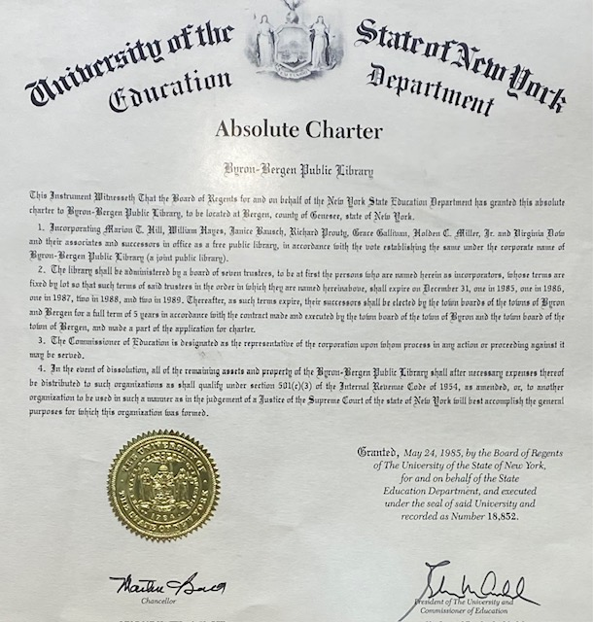
OUR Byron-Bergen Public Library
A critical part of the community since 1811
Chartered by NYS in 1985

Slide 3
PRESENTATION CONTENTS
01
02
03
04
05
About your Byron-Bergen Public Library (BBPL)
The Town of Byron Impact
What is Community Based Funding/a Municipal 414 Library ?
Taxpayer Impact
The Community Based Funding/Municipal 414 Vote

Slide 4
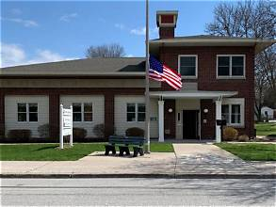
Our Library Use is on the Rise
Circulation has consistently increased!
Local organizations and neighbors meet, learn, and develop new skills.
We need to sustain and grow as a Municipal 414 Library.

Slide 5

What is a Municipal 414 Library?
Municipal 414 “enables libraries… to put their budget up for a public vote, held on election day, to establish the municipal budget appropriation for the library.”

Slide 6
We are a Municipal 414 Library
Our Library’s annual budget is supported by:
  Bergen taxpayers, who voted for this proposition.
  Byron taxpayers, through the Byron Town Board Vote, contributed 5% of the Library’s budget in 2026.
  Grants and Donations are inconsistent, not guaranteed, unpredictable, and time-consuming to solicit.

Slide 7
Moving forward as a Municipal 414 Library, our goals include:
Investing in new programming and resources:
  Language Learning Program
  Enrichment opportunities
  Expanding our Museum Pass Program
  Electronic Device Access
  Capital Project to expand facilities or preparing for significant rent increases
Adding a dedicated Assistant Library Manager
to expand preschool to young adult programming

Slide 8

We need YOUR HELP to fulfill these goals.
We need to stop depleting Reserve Funds to fulfill current financial obligations

Slide 9
Benefits of Byron Voter Approval
  Library stability
    Allows for consistent funding for long term planning
    Demonstrates a commitment to the education, well-being, and development of our community
  Contributes to the entire NYS Chartered Library service area of Byron and Bergen.
Notes:
Previously included:
Your Library cannot sustain operations using current sources of income
Your Library will need to tap into reserve funds, which could be used up in 2-3 years.

Slide 10
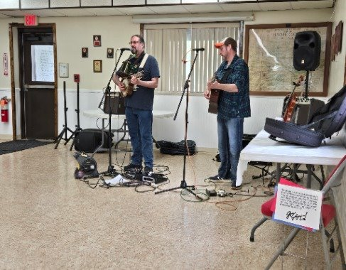
How has the Byron-Bergen Public Library served the Byron community Through the Decades?
Pre-school/ PreK outreach for more than 10 years
Previous participation in Byron Community Garage Sales at the Byron Presbyterian Church for more than 10 years
Provided music during the Memorial Day celebration at the Byron Fire Hall for almost 20 years

Slide 11
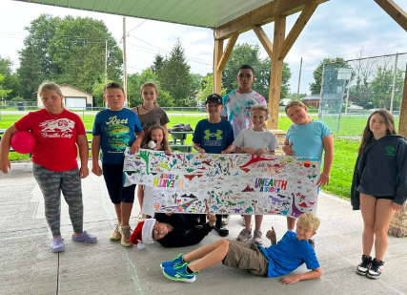
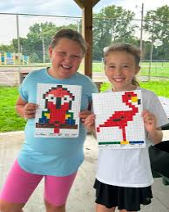
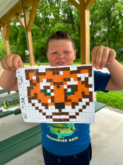
How does the Byron-Bergen Public Library serve the Byron community?
Annual Byron Recreation Camp Outreach
Notes:
I’d like to add how many years

Slide 12
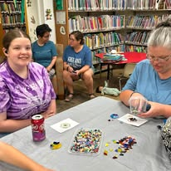
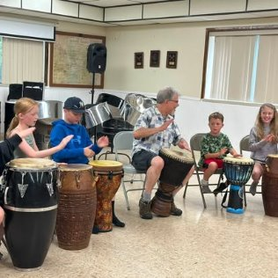
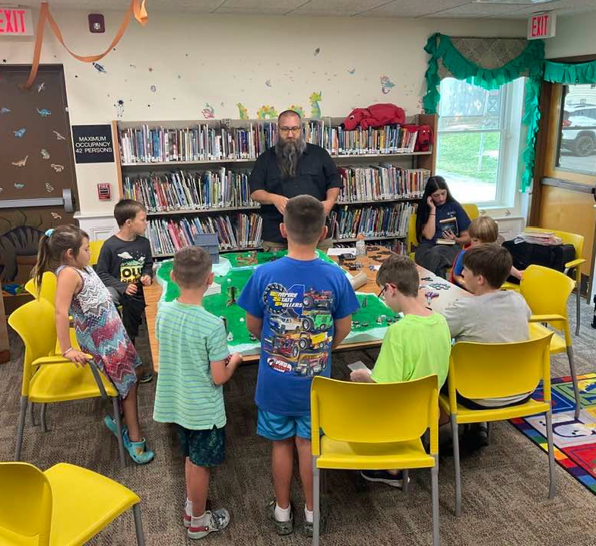
How has the Byron-Bergen Public Library served the Byron community?
Special Programs

Slide 13
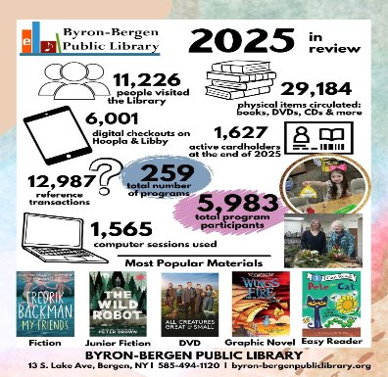

The Byron-Bergen Public Library has a line item to support Dolly Parton’s Imagination Library

Slide 14

SHALL THE TOWN OF BYRON ESTABLISH AN ANNUAL TAX OF $0.55/$1,000 (FIFTY-FIVE CENTS PER ONE THOUSAND DOLLARS) OF ASSESSED VALUE IN ORDER TO SUPPORT THE OPERATION OF THE BYRON-BERGEN PUBLIC LIBRARY, COMMENCING IN THE FISCAL YEAR BEGINNING JANUARY 1, 2027.
Yes O No O
  This Photo by Unknown Author is licensed under CC BY

Slide 15
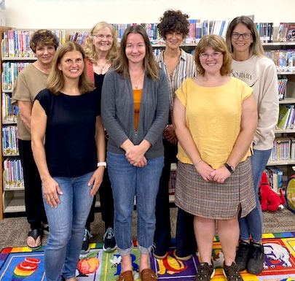
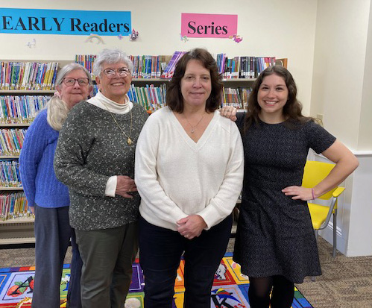
Your Team
Byron- Bergen Public Library Staff
Byron-Bergen Public Library Board of Trustees
Cheryl, Sandy, Nancy Bailey, Library Mgr., Zoey
Not pictured: Michelle
Rear: Anna Marie, Sally, Lauren, Krissy
Front: Heather, Katie, Bekah

Slide 16
THANK YOU
DO YOU HAVE ANY QUESTIONS?
byrbgn@nioga.org or bbpltrustee@gmail.com
(585) 494-1120
byron-bergenpubliclibrary.org

